Slide 1

Prevent Requests for Blocked Loans
Idea Exchange and CERV Enhancement (ID#36426)
Yoel Kortick | June 2026

Slide 2
Agenda
  Introduction
  An example before this development
  Using the new configuration
  An example after this development

Slide 3
Introduction

Slide 4
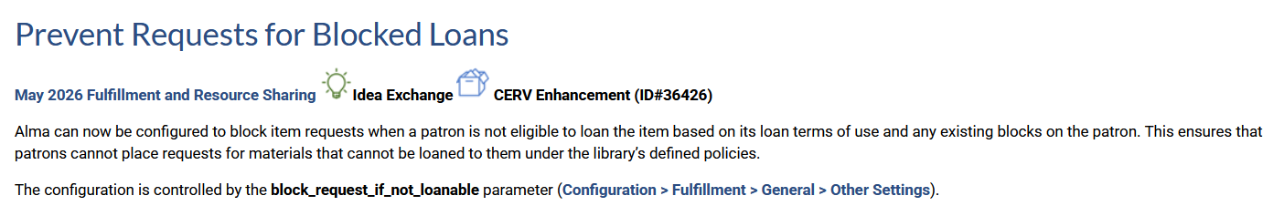
Introduction

Slide 5
Introduction
As of the May 2026 release it is possible to configure Alma to block item requests when a patron is not eligible to loan the item.
  The patron is not eligible to loan the item based on its loan terms of use and any existing blocks on the patron.
This ensures that a patron cannot place a request for materials that he or she cannot loan under the library’s defined policies.
The configuration is controlled by the parameter block_request_if_not_loanable
  This parameter is accessed at "Configuration > Fulfillment > General > Other Settings".

Slide 6
Introduction
The parameter block_request_if_not_loanable has three options:
  NONE — This is the default value. Alma implements the request as usual and does not check the loan eligibility.
  PHYSICAL — Physical requests (Hold, Booking) are allowed only if both loaning and requesting are allowed by the currently selected policies. If loans are not allowed for the item or patron, Alma blocks the request creation.
  ALL — This is the same as for PHYSICAL, but in this case, Alma blocks Digitization requests if loans are not allowed for the item or patron.

Slide 7
An example before this development

Slide 8
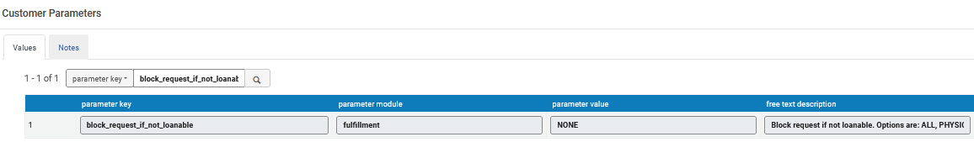
An example before this development
Currently the parameter block_request_if_not_loanable is "NONE".
Therefore, Alma is behaving as it did before the creation of this new parameter

Slide 9
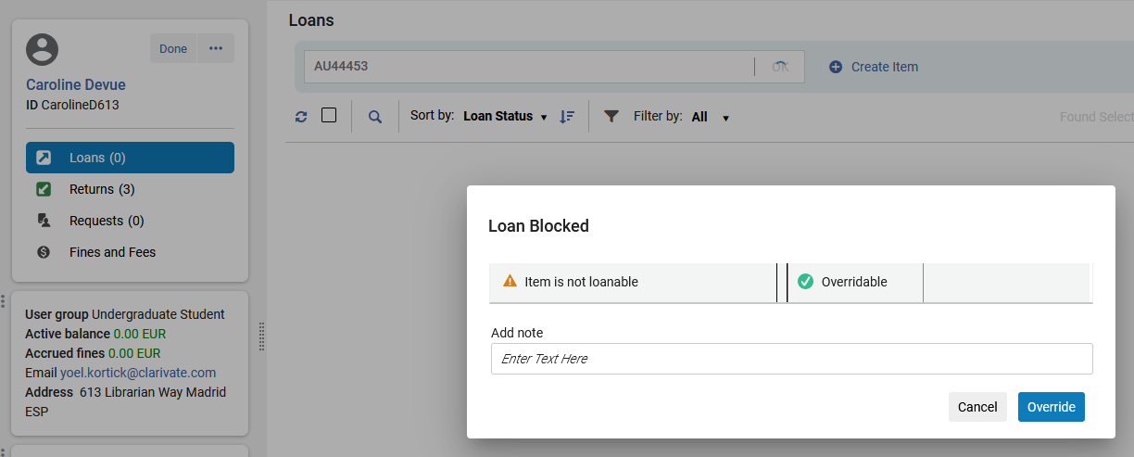
An example before this development
Patron Caroline Devue cannot loan title "Revisiting gender" item barcode AU44453

Slide 10
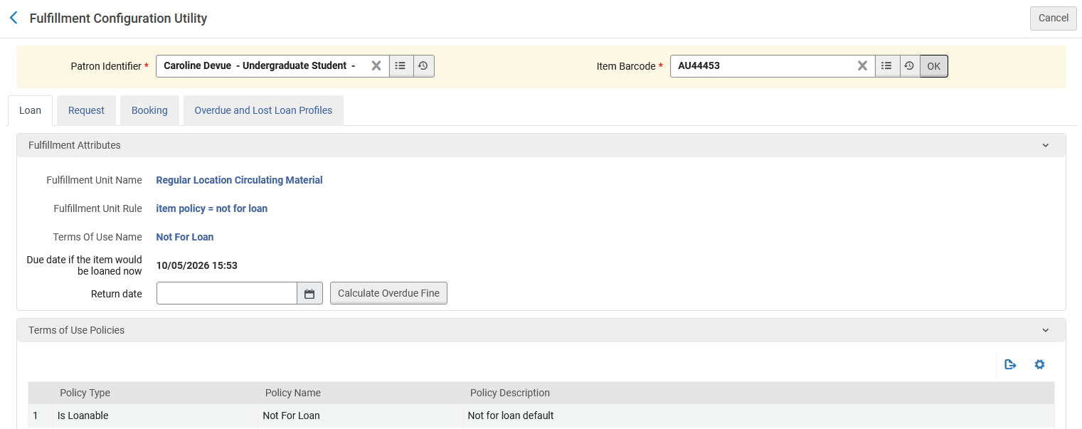
An example before this development
Using the configuration utility, we see that this is due to fulfilment configuration

Slide 11
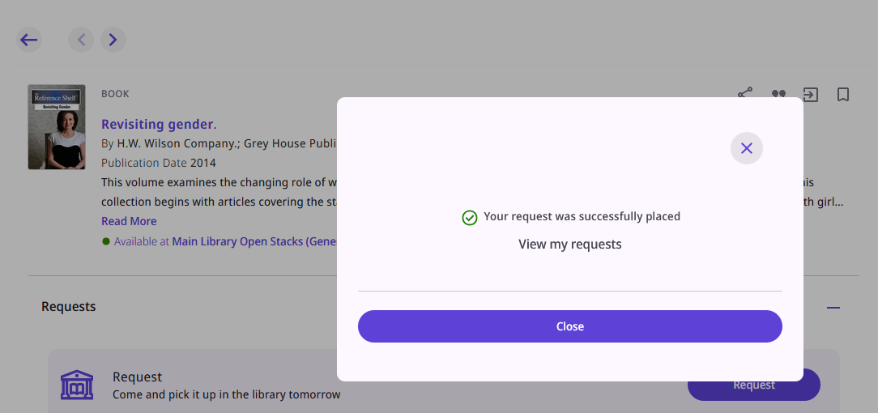
An example before this development
Even though the item cannot be loaned to Caroline Devue, Caroline can request the item in discovery

Slide 12
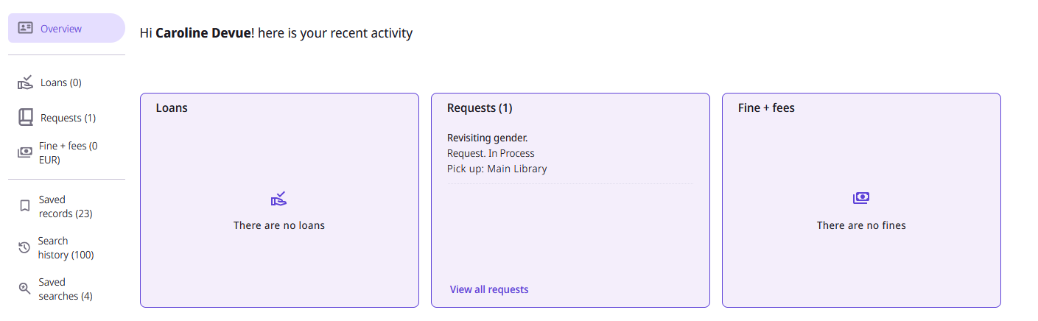
An example before this development
The request has been created for the user.

Slide 13
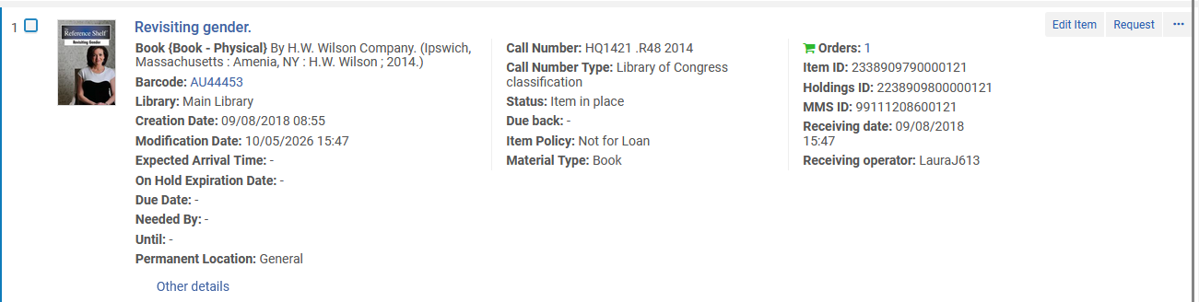
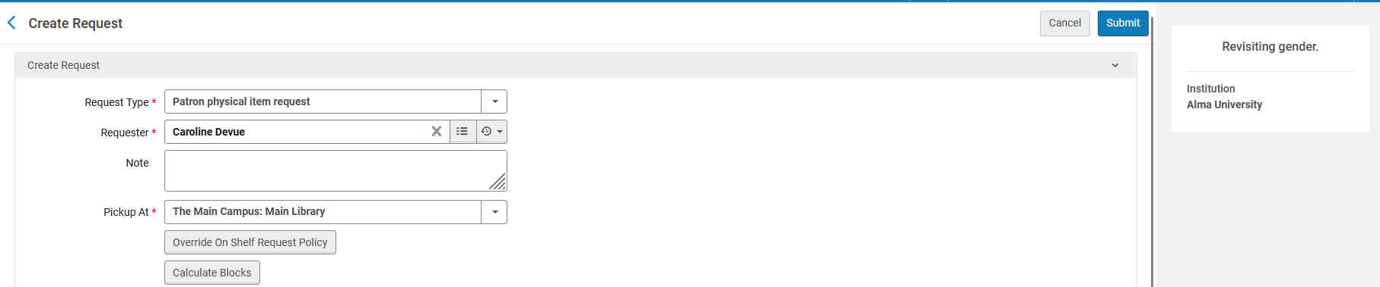
An example before this development
The request can also be created for the user in Alma by a staff user.

Slide 14
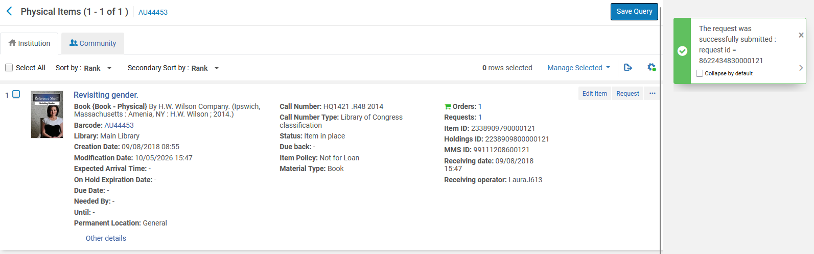
An example before this development
The request has been created for the user in Alma by a staff user.

Slide 15
Using the new configuration

Slide 16
Using the new configuration
Parameter "block_request_if_not_loanable " has been changed from NONE to PHYSICAL
Before
After

Slide 17
An example after this development

Slide 18
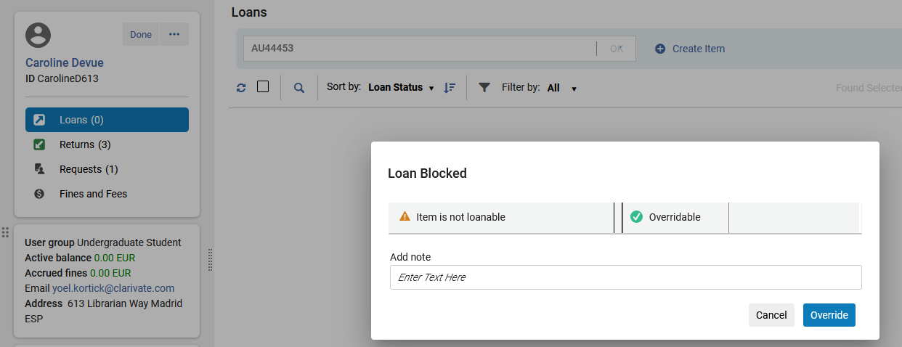
An example after this development
Patron Caroline Devue still cannot loan title "Revisiting gender" item barcode AU44453

Slide 19
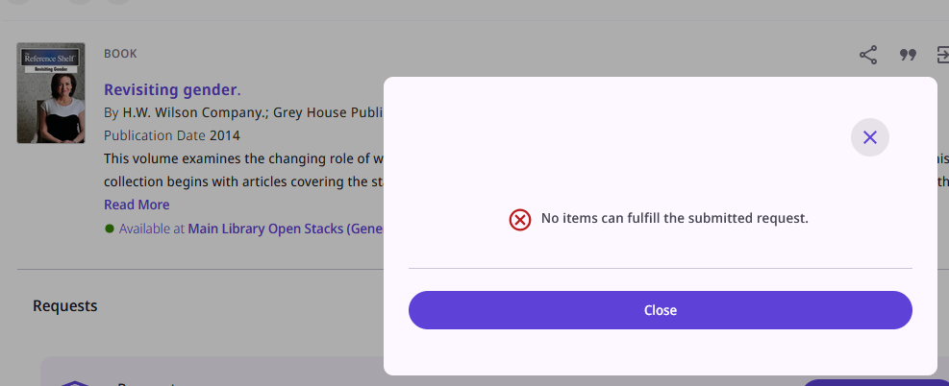
An example after this development
Now, because we defined PHYSICAL for parameter block_request_if_not_loanable , patron Caroline Devue can no longer make a request for title "Revisiting gender" item barcode AU44453. This is because she cannot loan it.

Slide 20
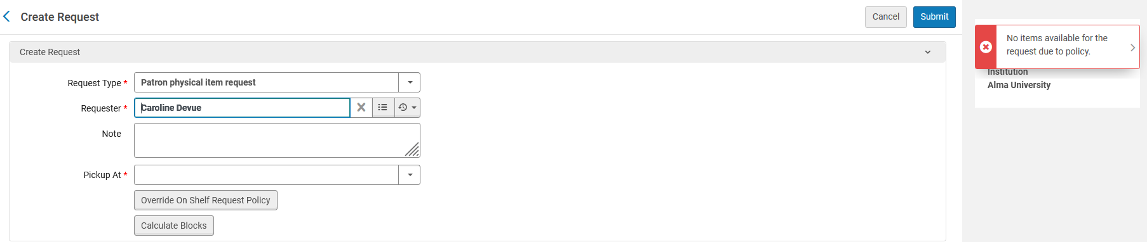
An example after this development
The request can also not be created by a staff user in Alma for Caroline:

